Slide 1
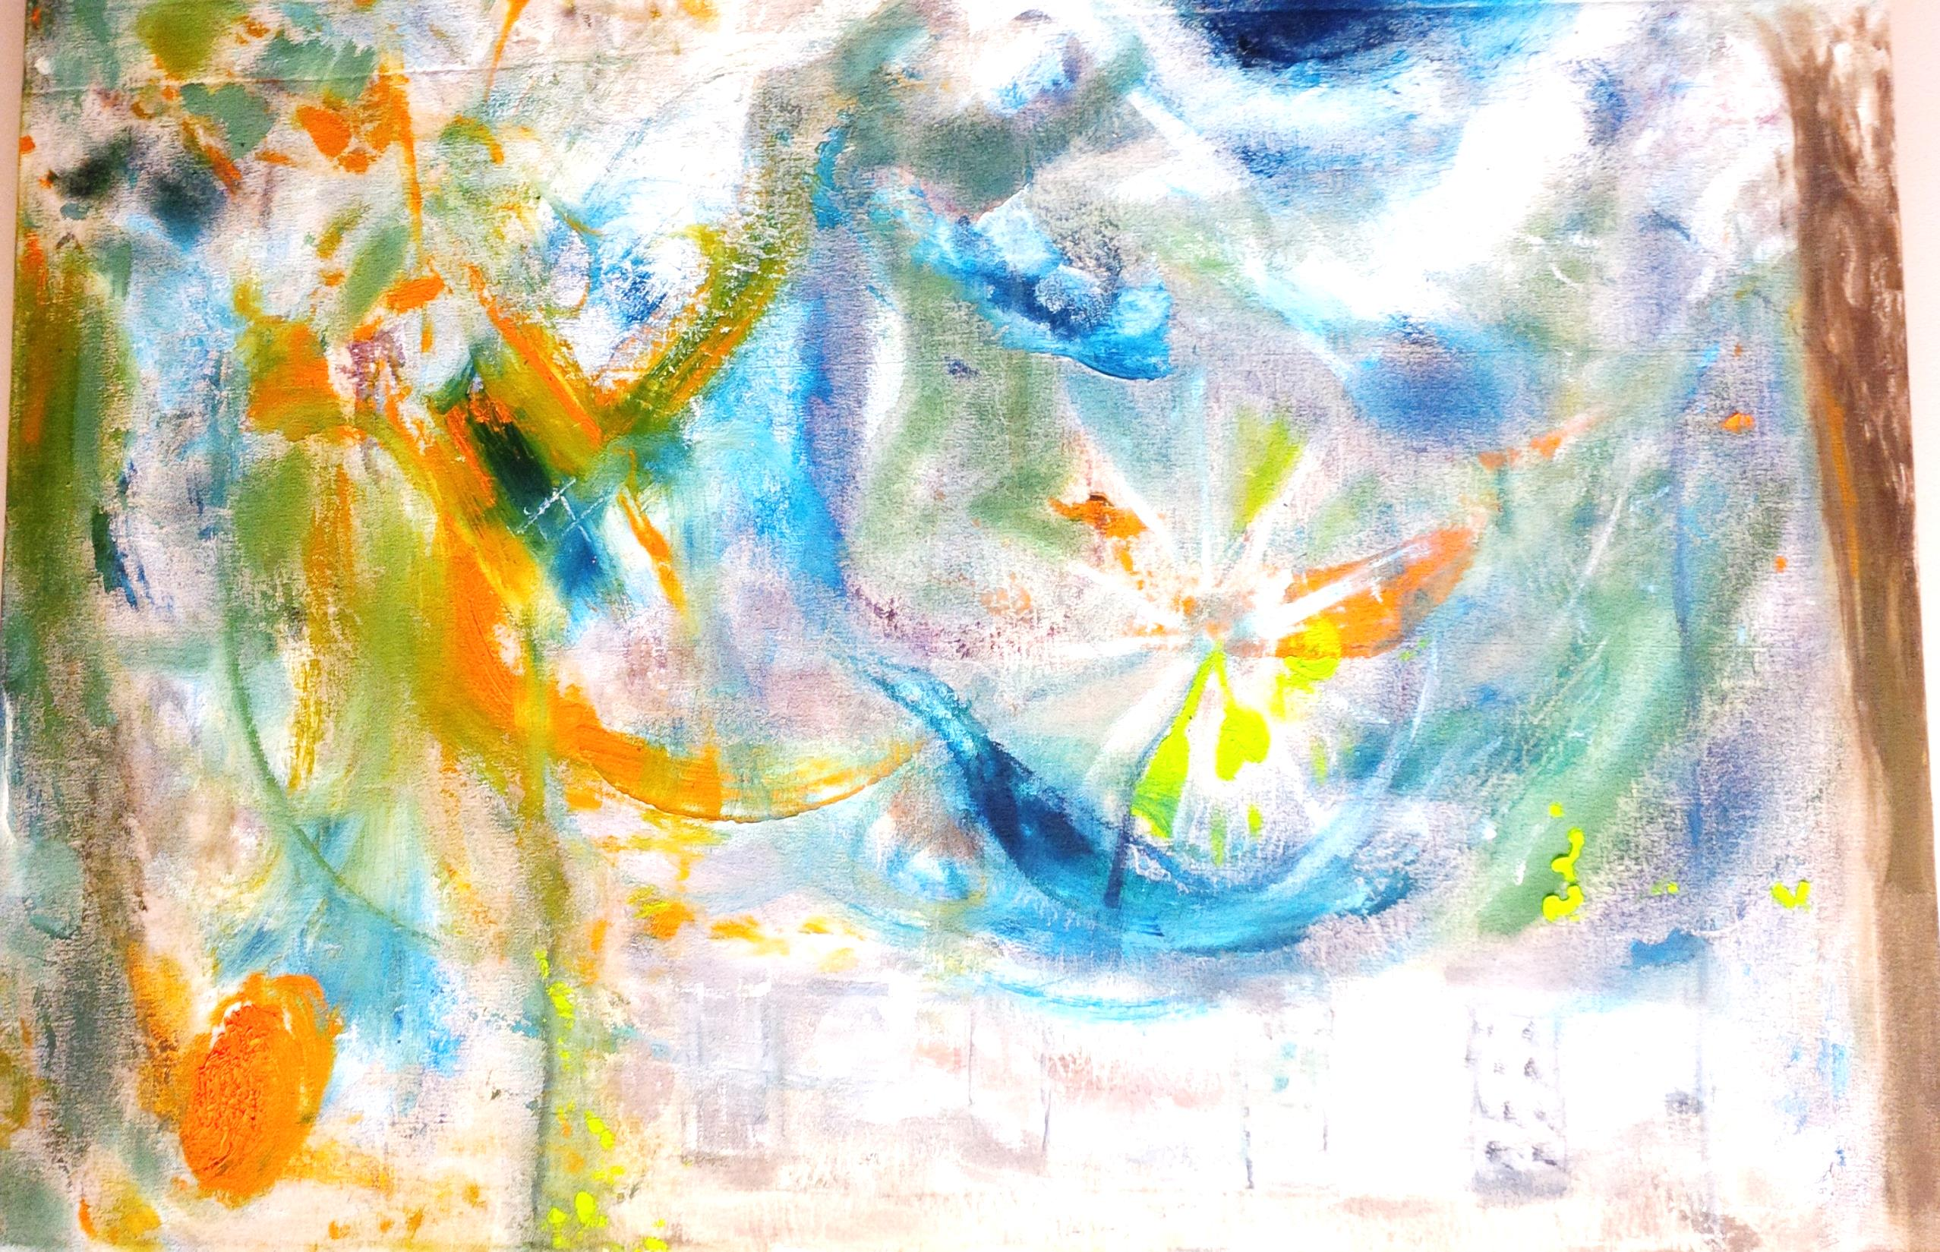

THE STORY OF MY LIFE

Slide 2
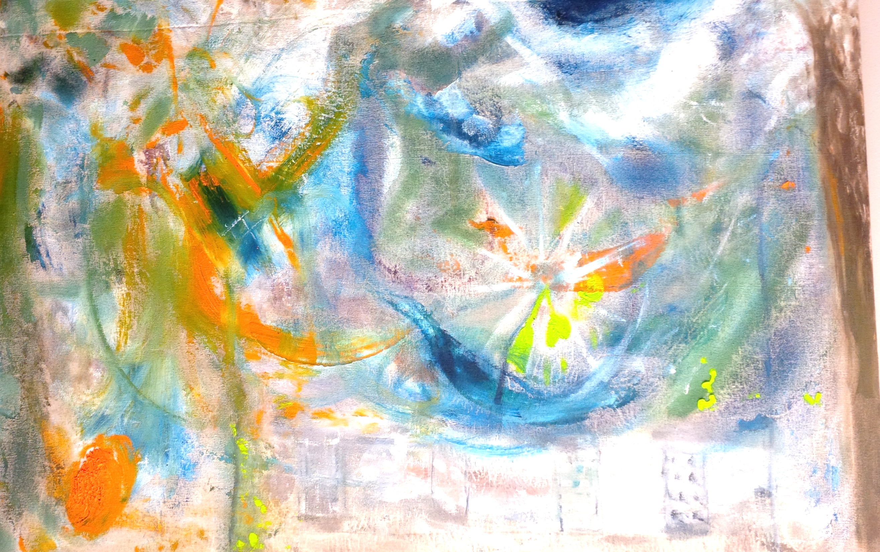
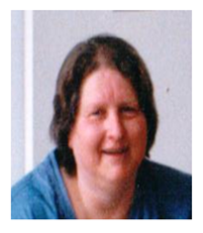
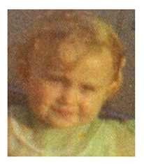
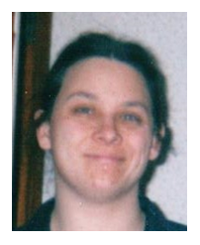
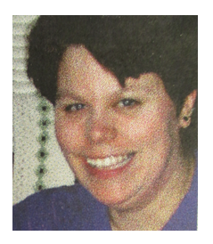
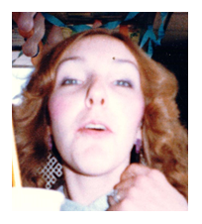
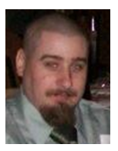
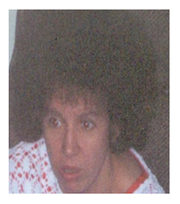
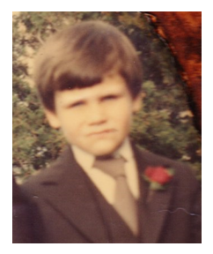
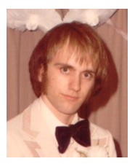

Slide 3
“I know from my experience that hanging around certain places starts to get to you... I try and stay positive and be around people who support me.”

Slide 4
`
“I am grateful to everyone who has made me feel welcome and opened their hearts to me. I am currently attending a Self Esteem Group in my ongoing efforts to continually better myself.”

Slide 5
“The temptation to drink will ALWAYS be there but I am stronger now by finally acknowledging that I have depression and seeking help and knowing that asking for help is not a sign of weakness, but a sign of strength. Letting go of the pain and anger and experiencing real joy.”

Slide 6
“When I’m in the Centre I am clean, I don’t use, we can’t use and so that’s one big reason that we come to the Centre and hang out at the Centre, cause we can stay clean for the time it is open.”

Slide 7
“I came back to Peer 17 and realized they could help me more than my Mental Health Counsellor could, because I am with other people who “walk the walk” and “talk the talk”.”

Slide 8
“I have other medical problems and by learning about them I have learned to fight them which helped me to keep on getting better daily.”

Slide 9
“I’ve been told that I’m a survivor given what I’ve been through.”

Slide 10
“It was great to chat to people who have been in similar situations.”

Slide 11
“I’ve got a place here at the Centre “Life House”. I don’t know what we would do without it, I really don’t.”

Slide 12
“The stories, and the people are different and so familiar, no matter what your illness is there is always hope.”

Slide 13
“The members are great and it was nice to find people who have been through similar situations. It was and is a great comfort.”

Slide 14
“I have developed my own coping strategies through my life and I don’t let it consume me.”

Slide 15
“At one point in my life I was in darkness that I didn’t think even God could pull me out of but there isn’t anything that you can’t come back from if you accept the help that is available.”

Slide 16
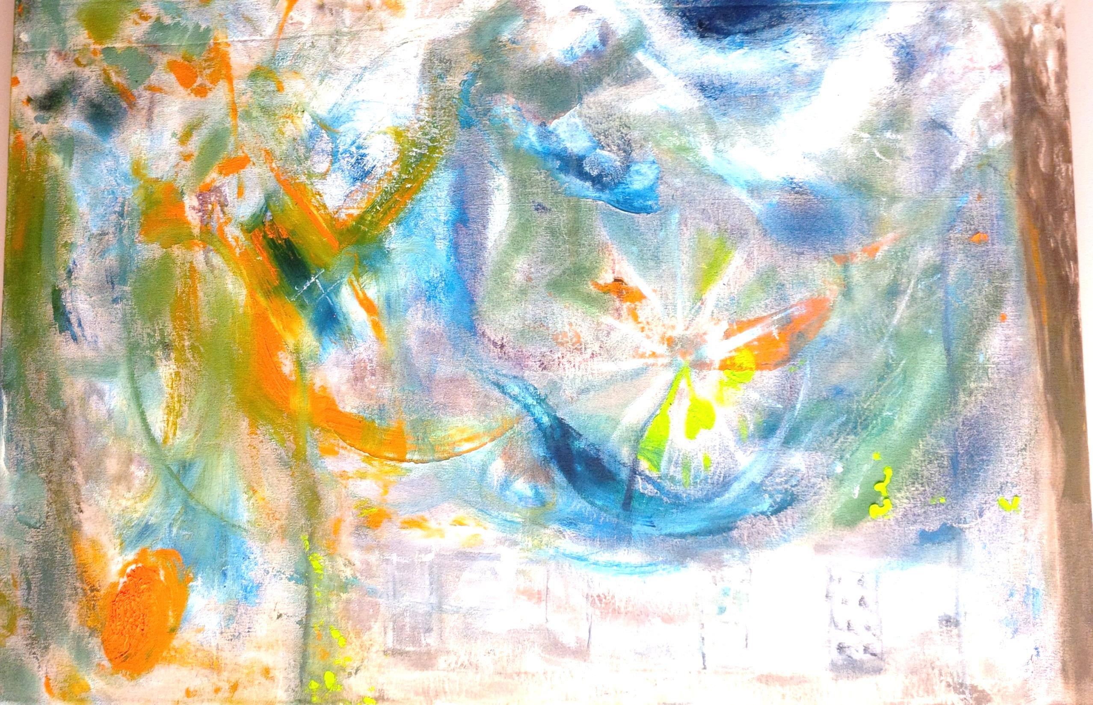
“Life House where I could find support… going on my own and over time became more confident and felt supported and loved. I mattered.”

Slide 17
“Today I still struggle with my hurts, habits and hang-ups, but with God’s love, Freedom Centre’s love and Steve’s love and grace, I am doing very well.”

Slide 18
“I'm happy, living life to the fullest, fully working through my own personal challenges.”

Slide 19
“I have weathered the storm and the sun is finally shining again.”

Slide 20
“I have not used in 7 years and although I can’t go back and change the past, I mustn’t forget it because it has made me who I am today and is a reminder as to who I want to be tomorrow.”

